Slide 1
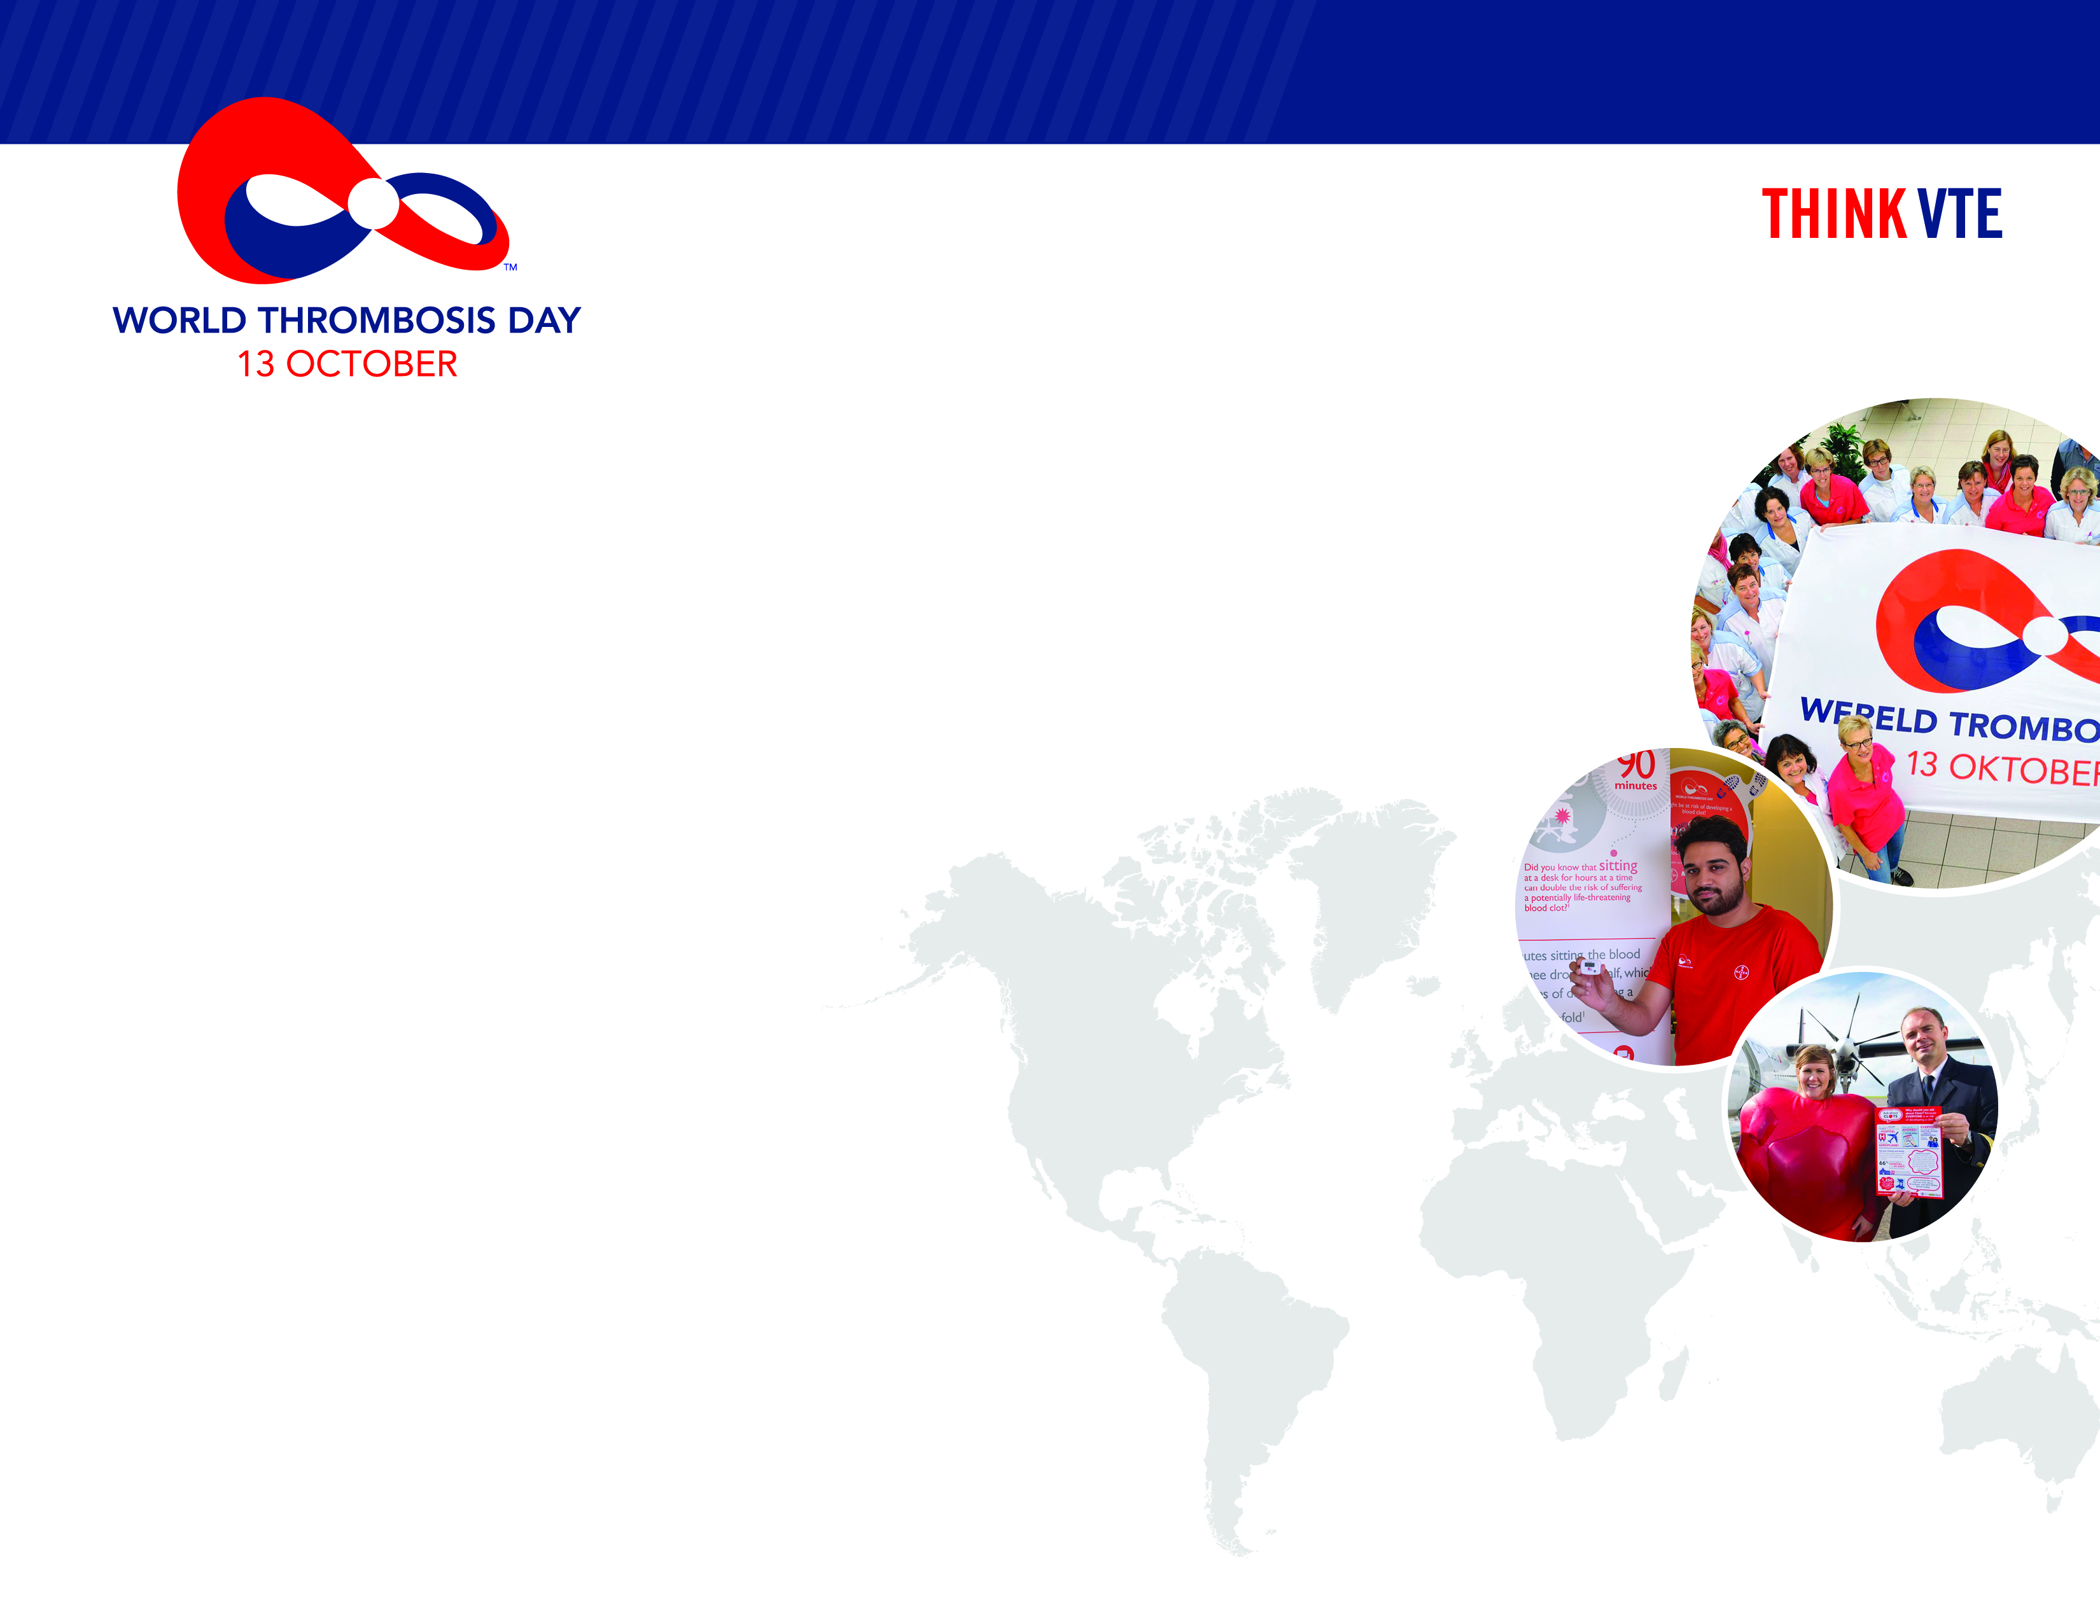
The global movement to stop blood clots and save lives.
Join Us
As a partner, supporter, community mobilizer.
More than 200 groups already have. Will you?
Stay Connected at WorldThrombosisDay.org
Did you know?
Up to 60% of all VTE cases occur during or after hospitalization, making it a leading cause of preventable hospital death. Education and prevention are key to reducing death and disability.

